Slide 1

WorkshoP

Slide 2
Robert Griesemer
Rob Pike
Ken Thompson
V8 JavaScript
Unix
Plan 9
Co-créateur de l’UTF-8
Sa femme Renée French a créé le gopher
Unix
B (langage)
Plan 9
Co-créateur de l’UTF-8
2007
2009
2012
Début du développement
Annonce publique
Première version

Slide 3

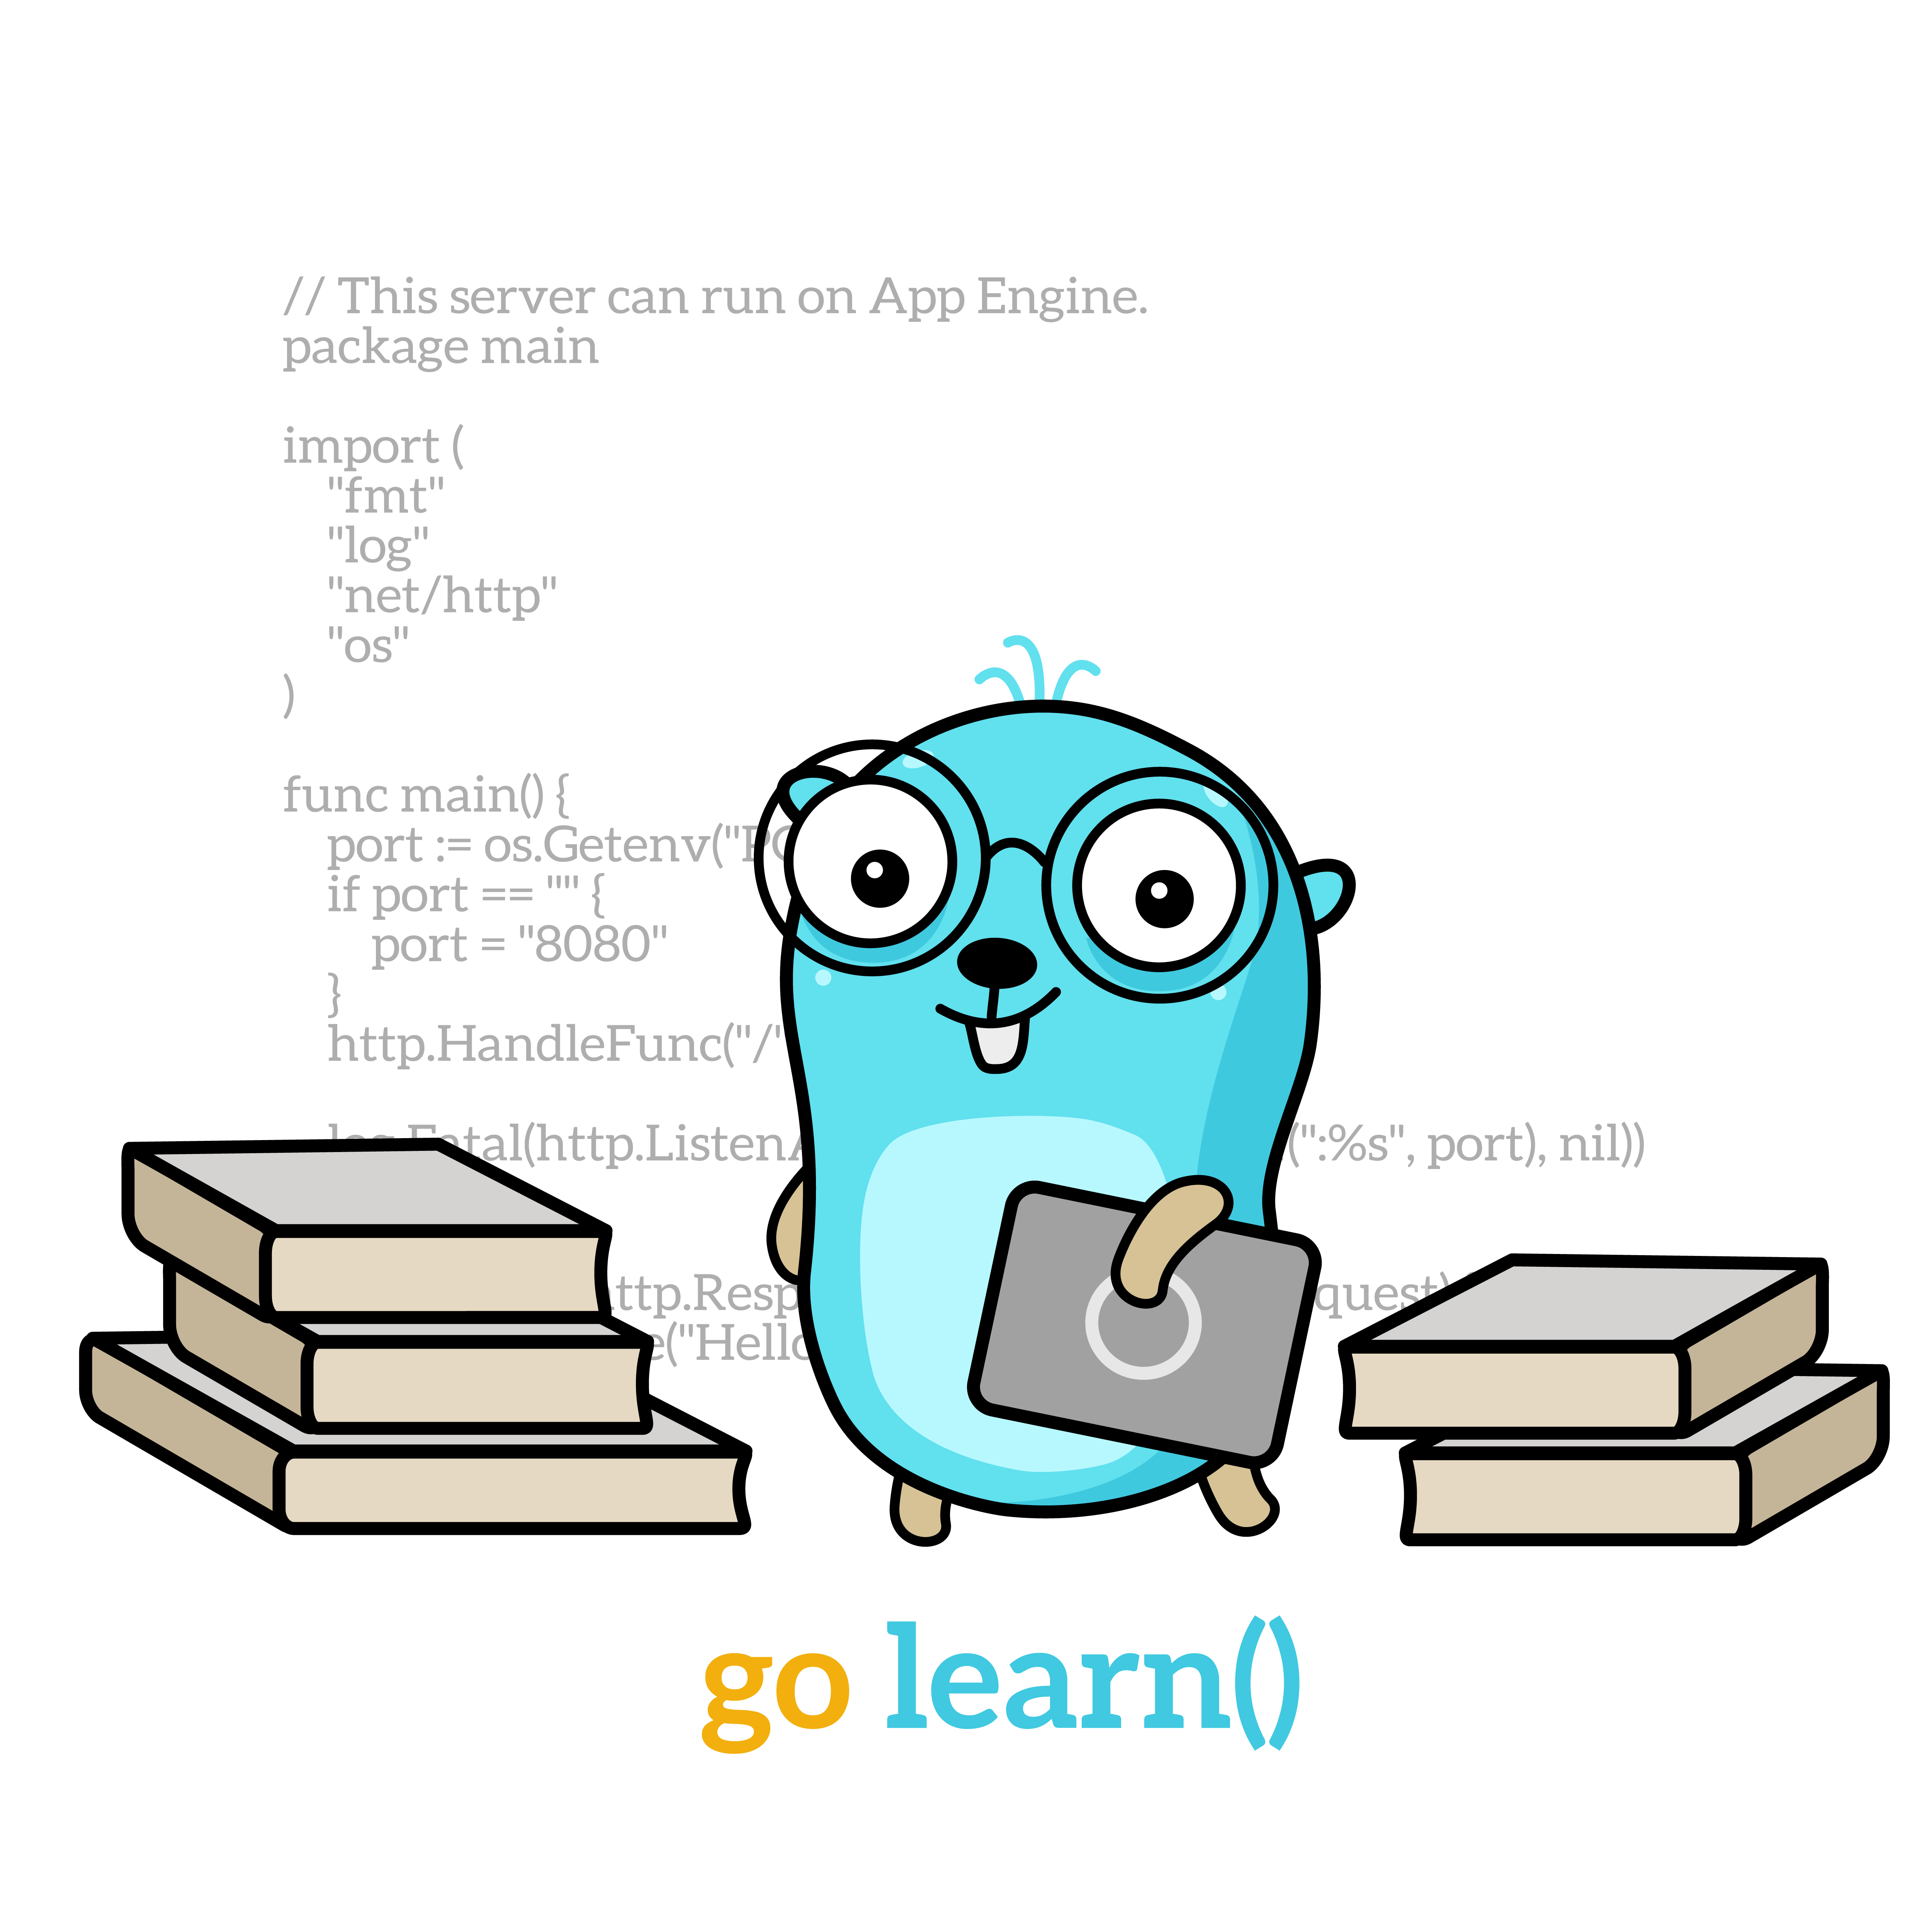
• Typé
• Compilé
• Syntaxe similaire au C
• Memory safety
• Garbage collection
• Structural typing
• Concurrency

Slide 4
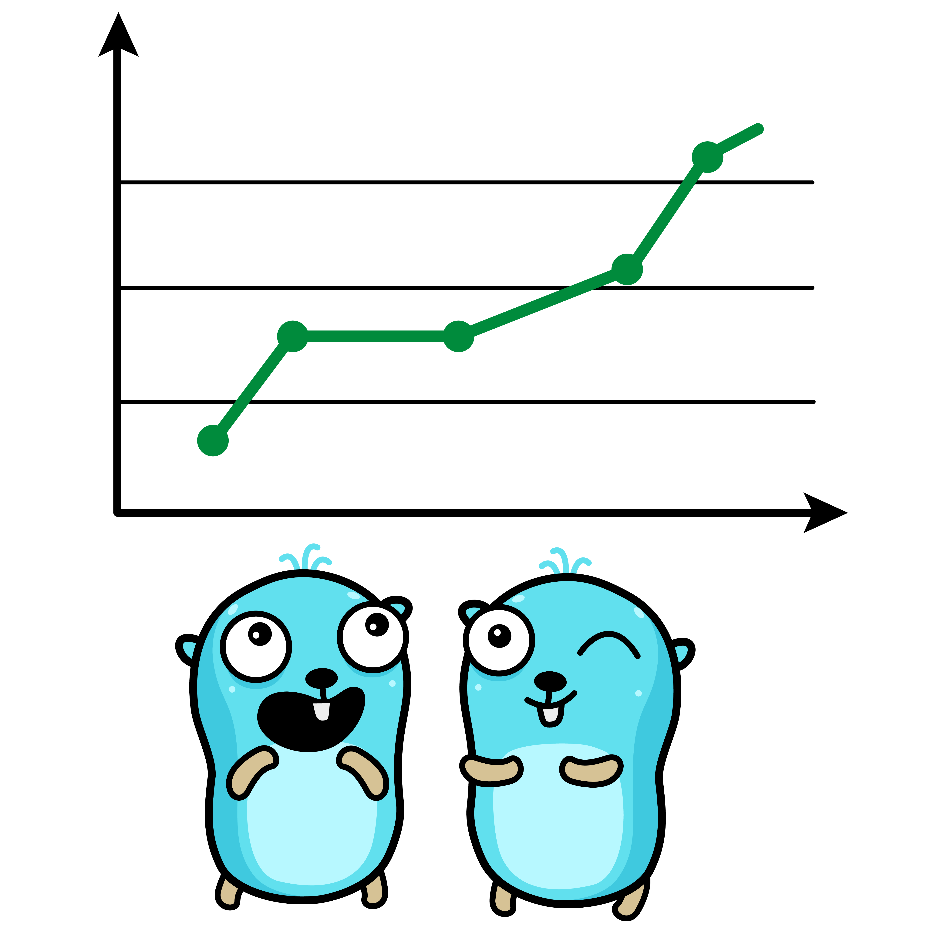
github.com/golang/go
1463 contributeurs
68.7Kk stars
13ème langage le plus utilisé
2
3ème langage le mieux payé
6

Slide 5
package main
import (
"fmt"
)
func main() {
fmt.Println("Hello World")
}

Slide 6
func myFunc(x int, y int) int {
return x + y
}
func swap(x, y string) (string, string) {
return y, x
}

Slide 7
var i int
var i int = 0
i := 0
string
bool
int8, uint8 (byte), int16, uint16, int32 (rune), uint32, int64, uint64, int, uint, uintptr
float32, float64
complex64, complex128

Slide 8
for i := 0; i < 10; i++ {
sum += i
}
sum := 1
for sum < 1000 {
sum += sum
}
for {
}

Slide 9
if x < 0 {
return
}
if err := func(); err != nil {
log.Fatal(err)
}

Slide 10
func main() {
defer fmt.Println("world")
fmt.Println("hello")
}

Slide 11
i, j := 42, 2701
p := &i // point to i
fmt.Println(*p) // read i through the pointer
*p = 21 // set i through the pointer
fmt.Println(i) // see the new value of i
p = &j // point to j
*p = *p / 37 // divide j through the pointer
fmt.Println(j) // see the new value of j

Slide 12
type Vertex struct {
X int
Y int
}
func main() {
v := Vertex{1, 2}
v.X = 4
fmt.Println(v.X)
}

Slide 13
func say(s string) {
for i := 0; i < 5; i++ {
time.Sleep(100 * time.Millisecond)
fmt.Println(s)
}
}
func main() {
go say("world")
say("hello")
}

Slide 14


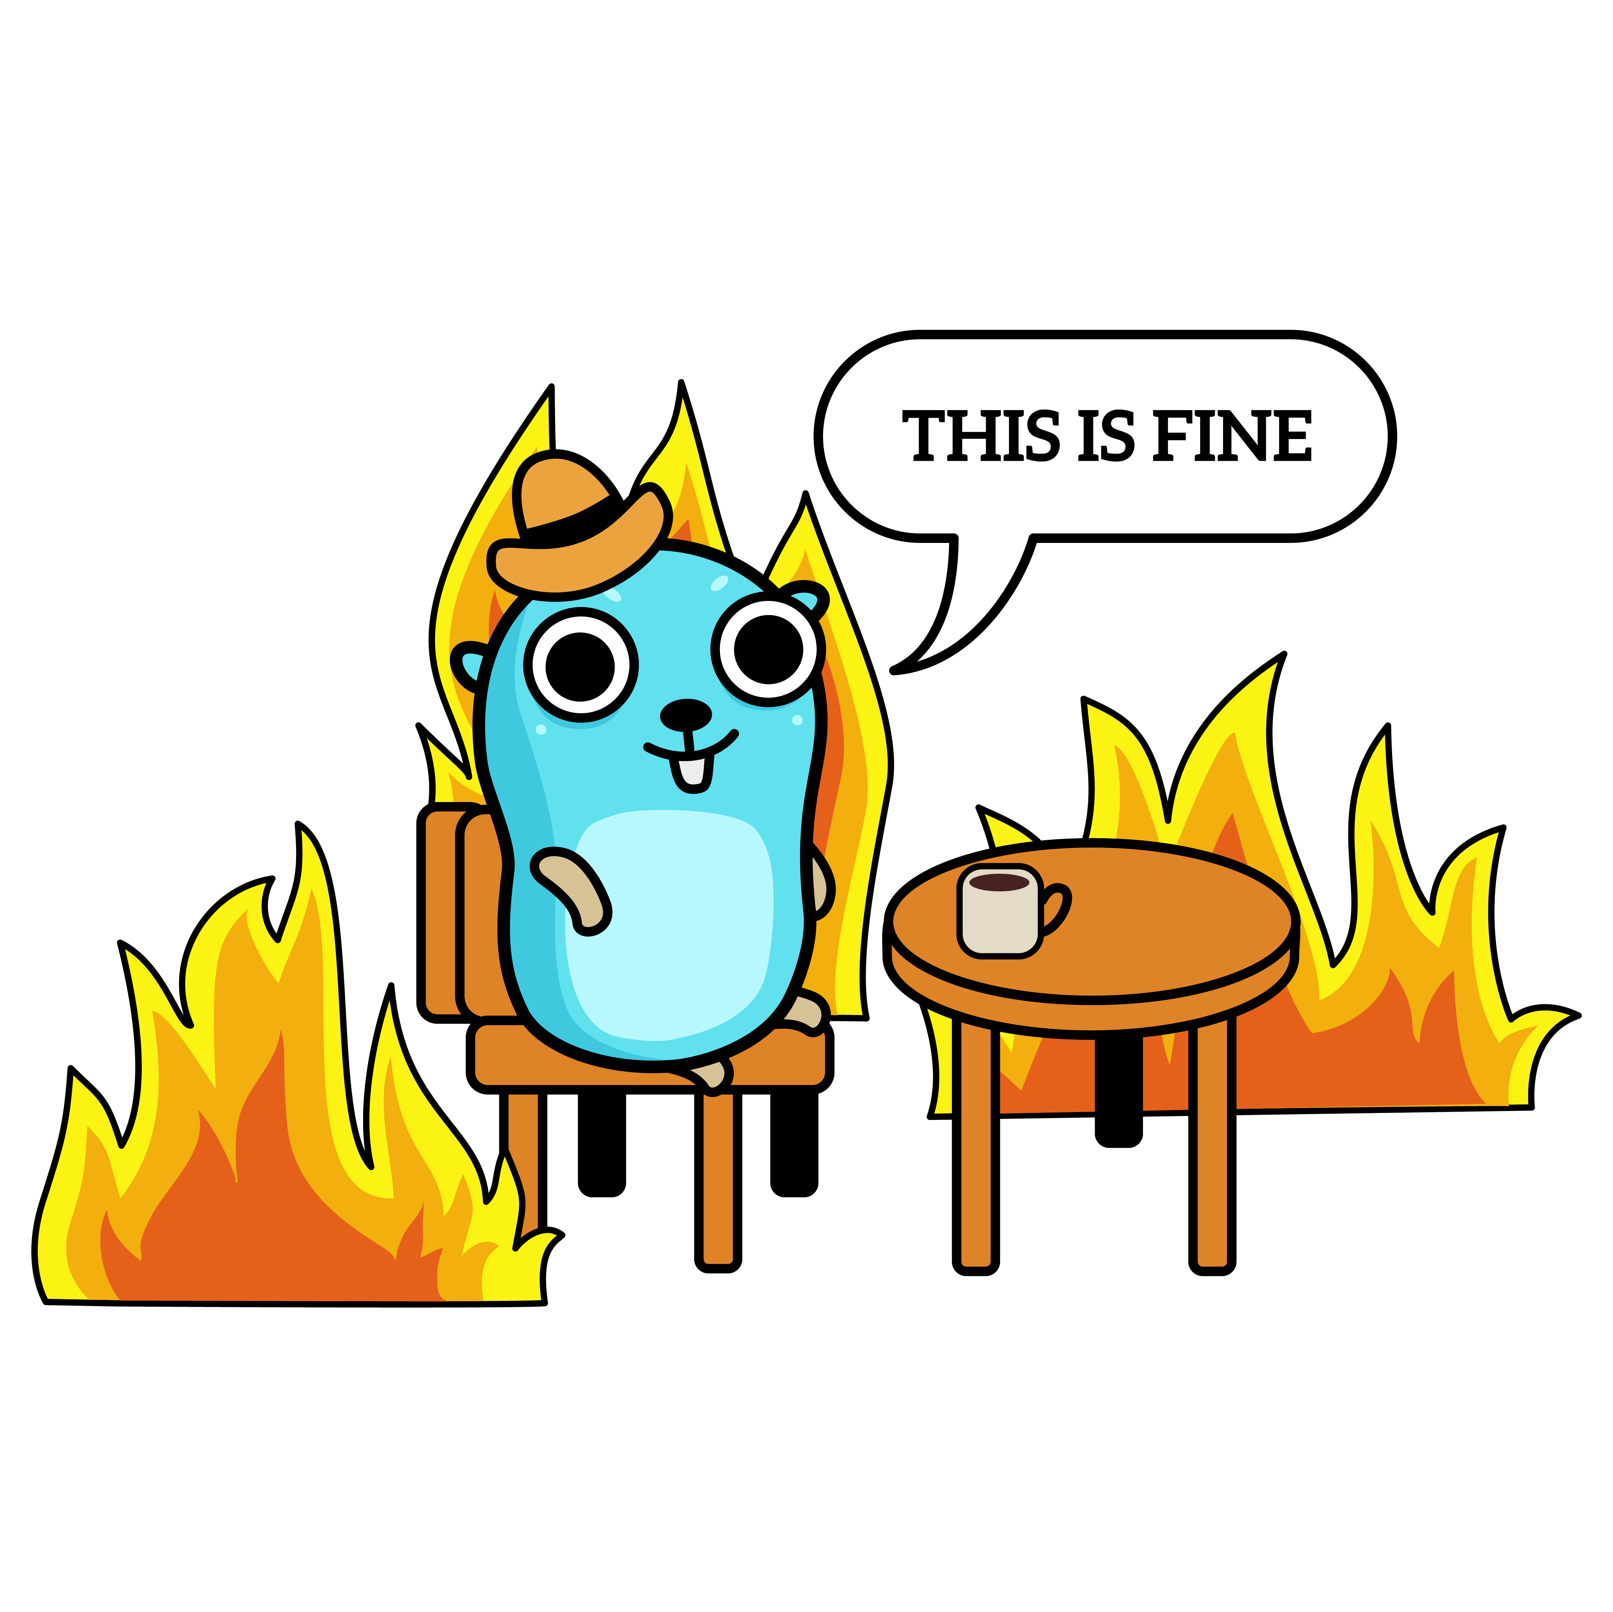
github.com/victorneuret/WorkshopGo

